Slide 1
Fundamental of Information technology
Unit -I
Introduction to Computers

Slide 2
Meaning of the word "Computer"
Computer is derived from a Latin word “computare” which means to “to calculate", "to count”, “to sum up” So, more precisely the word computer means a "device that performs computation".

Slide 3
A computer is an electronic machine that accepts data from the user, processes the data by performing calculations and operations on it, and generates the desired output results.
Computer is an advanced electronic device that takes raw data as an input from the user and processes it under the control of a set of instructions (called program), produces a result (output), and saves it for future use

Slide 4
− Step 1 − Takes data as input. Step 2 − Stores the data/instructions in its memory and uses them as required. Step 3 − Processes the data and converts it into useful information. Step 4 − Generates the output.
Functionalities of a Computer

Slide 5
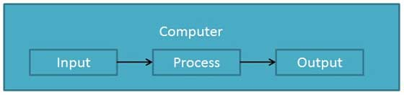
Data Processing
The activity of processing data using a computer is called data processing

Slide 6
DATA : is a collection of independent and unorganized facts.
INFORMATION is the processed and organized data presented in a meaningful form.

Slide 7
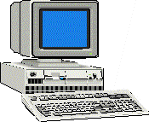
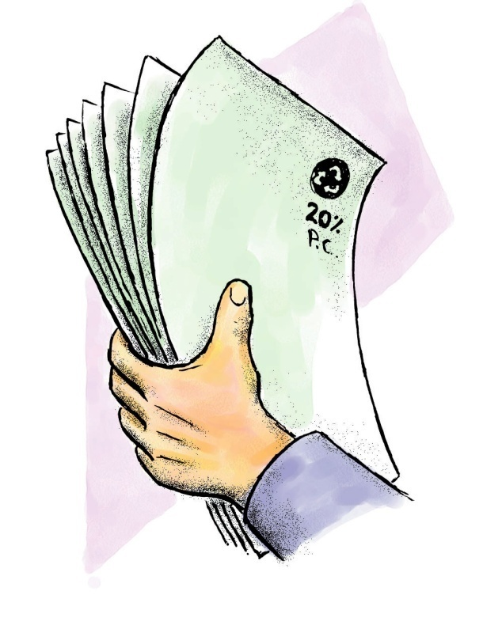
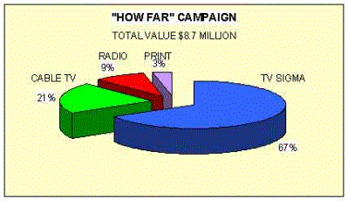
PROCESSING SYSTEM
DATA
INFORMATION
DATA

Slide 8
Characteristics of Computers
Automatic: Given a job, computer can work on it automatically without human interventions
Speed: Computer can perform data processing jobs very fast, usually measured in microseconds (10⁻⁶), nanoseconds (10⁻⁹), and picoseconds (10⁻¹²)
Accuracy: Accuracy of a computer is consistently high and the degree of its accuracy depends upon its design. Computer errors caused due to incorrect input data or unreliable programs are often referred to as Garbage- In-Garbage-Out (GIGO)

Slide 9
Diligence: Computer is free from monotony, tiredness, and lack of concentration. It can continuously work for hours without creating any error and without grumbling
Versatility: Computer is capable of performing almost any task, if the task can be reduced to a finite series of logical steps
Power of Remembering: Computer can store and recall any amount of information because of its
secondary storage capability. It forgets or looses certain
information only when it is asked to do so

Slide 10
Capabilities And Limitation Of Computer

Slide 11
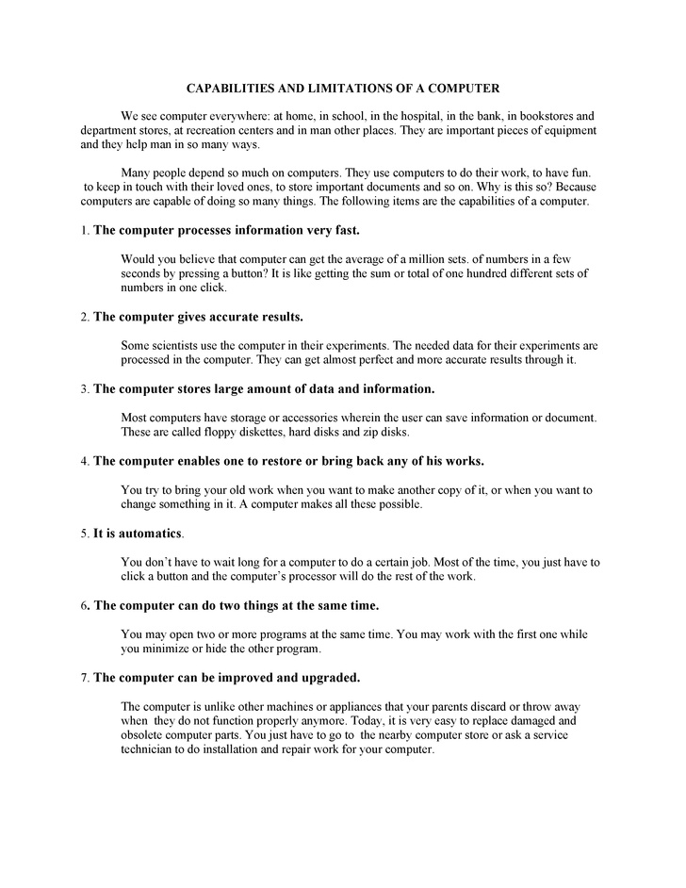

Slide 13
Limitations of Computer
1. The Computer does not work on itself, it requires set of instructions to be provided, and else computer (Hardware) is waste.
2. Computers are not intelligent, they have to be instructed about each and every step which they have to perform
3. Computers cannot take decisions on its own, one has to program the computer to take an action if some conditional prevail.
4) Computers unlike humans, cannot learn by experience.

Slide 14
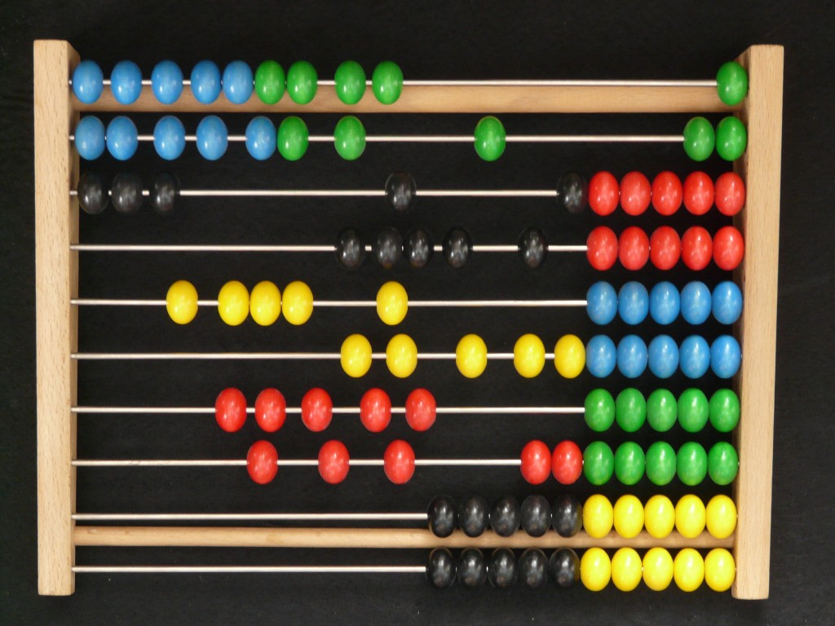
Evolution of Computers
The earliest known device for calculation is Abacus to perform simple calculation.

Slide 15
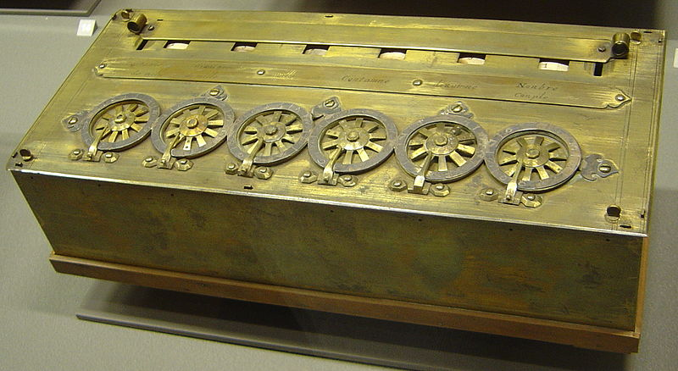
Blaise Pascal invented the first mechanical adding machine in 1642
Pascaline is a calculating machine developed by Blaise Pascal, a French Mathematician. It was the first device with an ability to perform additions and subtractions on whole numbers.

Slide 16
Baron Gottfried Wilhelm von Leibniz invented the first calculator for multiplication in 1671
Around 1880, Herman Hollerith came up with the concept of punched cards that were extensively used as input media until late 1970s

Slide 17
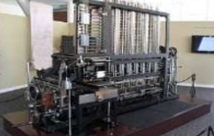
Charles Babbage is considered to be the father of modern digital computers. He designed a fully automatic analytical engine in 1842 for performing basic arithmetic functions

Slide 18
Some Well Known Early Computers
The Mark I Computer (1937-44)
The Atanasoff-Berry Computer (1939-42)
The ENIAC (1943-46)
The EDVAC (1946-52)
The EDSAC (1947-49)
Manchester Mark I (1948)
The UNIVAC I (1951)

Slide 19
Computer Generations
“Generation” in computer talk is a step in technology. It
provides a framework for the growth of computer industry
Originally it was used to distinguish between various
hardware technologies, but now it has been extended to
include both hardware and software . Till today, there are five computer generations

Slide 20
First Generation: Vacuum Tubes (1940-1955)
The first computers used vacuum tubes for circuitry and magnetic drums for memory, and were often enormous, taking up entire rooms. These computers were very expensive to operate and in addition to using a great deal of electricity, the first computers generated a lot of heat, which was often the cause of malfunctions.
First generation computers relied on machine language, the lowest-level programming language understood by computers, to perform operations, and they could only solve one problem at a time. It would take operators days or even weeks to set-up a new problem. Input was based on punched cards and paper tape, and output was displayed on printouts.

Slide 21
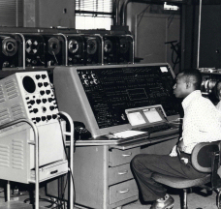
The UNIVAC and ENIAC computers are examples of first-generation computing devices. The UNIVAC was the first commercial computer delivered to a business client, the U.S. Census Bureau in 1951.
A UNIVAC computer at the Census Bureau.

Slide 22
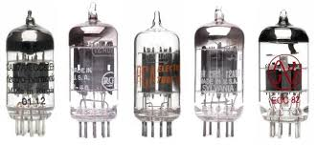
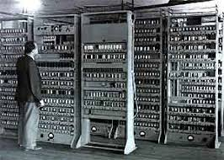

Slide 23
Second Generation: Transistors (1956-1964)
The transistor was invented at Bell Labs in 1947 .
The transistor was far superior to the vacuum tube, allowing computers to become smaller, faster, cheaper, more energy-efficient and more reliable than their first-generation predecessors. Though the transistor still generated a great deal of heat that subjected the computer to damage, it was a vast improvement over the vacuum tube. Second-generation computers still relied on punched cards for input and printouts for output.
From Binary to Assembly

Slide 24
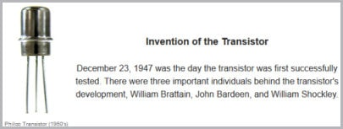
Second-generation computers moved from cryptic binary machine language to symbolic, or assembly, languages, which allowed programmers to specify instructions in words. High-level programming languages were also being developed at this time, such as early versions of COBOL and FORTRAN. These were also the first computers that stored their instructions in their memory, which moved from a magnetic drum to magnetic core technology.

Slide 25
Third Generation: Integrated Circuits (1964-1975)
The development of the integrated circuit was the hallmark of the third generation of computers. Transistors were miniaturized and placed on silicon chips, called semiconductors, which drastically increased the speed and efficiency of computers.
Instead of punched cards and printouts, users interacted with third generation computers through keyboards and monitors and interfaced with an operating system, which allowed the device to run many different applications at one time with a central program that monitored the memory. Computers for the first time became accessible to a mass audience because they were smaller and cheaper than their predecessors.

Slide 26
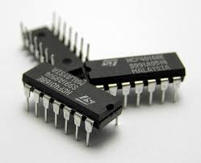
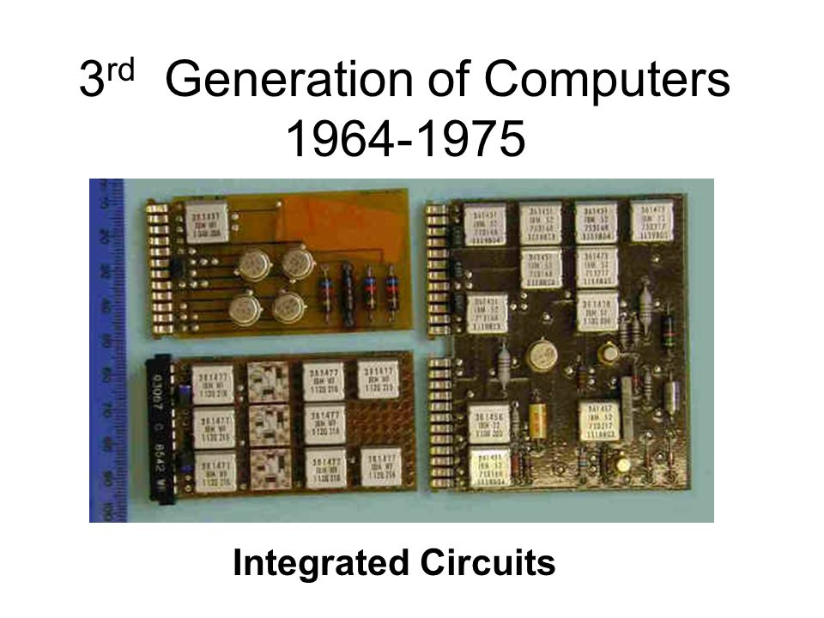

Slide 27
Fourth Generation :1976-1989.
The fourth generation of computers is marked by the use of Very Large Scale Integrated (VLSI) circuits.VLSI circuits having about 5000 transistors and other circuit elements and their associated circuits on a single chip made it possible to have microcomputers of fourth generation. Fourth Generation computers became more powerful, compact, reliable, and affordable. As a result, it gave rise to personal computer (PC) revolution. In this generation Time sharing, Real time, Networks, Distributed Operating System were used. All the Higher level languages like C and C++, DBASE etc. were used in this generation.

Slide 28
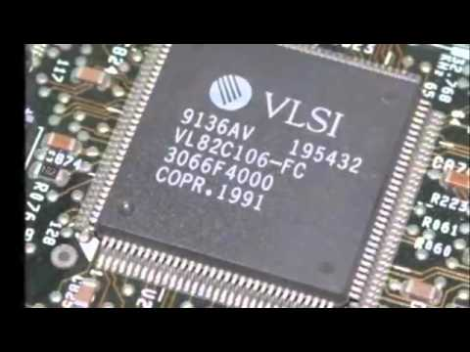

Slide 29
Fifth Generation The period of Fifth Generation is 1990-till date.
Fifth Generation The period of Fifth Generation is 1990-till date. In the fifth generation, the VLSI technology became ULSI (Ultra Large Scale Integration) technology, resulting in the production of microprocessor chips having ten million electronic components. This generation is based on parallel processing hardware and AI (Artificial Intelligence) software. AI is an emerging branch in computer science, which interprets means and method of making computers think like human beings. All the Higher level languages like C and C++, Java, .Net etc. are used in this generation. AI includes: • Robotics • Neural networks • Game Playing • Development of expert systems to make decisions in real life situations.

Slide 30
Applications of computers in today's arena.
A computer has high speed of calculation, diligence, accuracy, reliability, or versatility which made it an integrated part of almost every area.

Slide 31
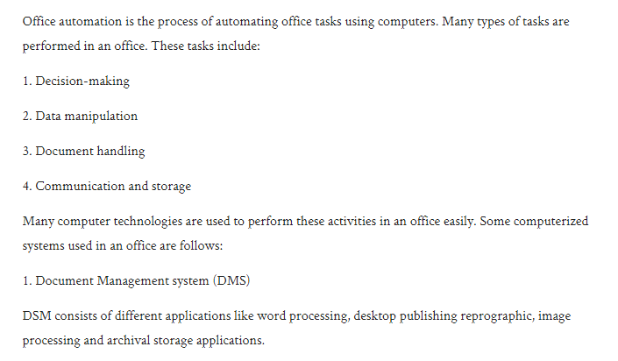
Office Automation

Slide 32
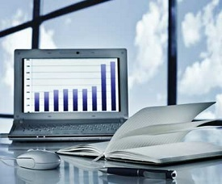
business
Computer is used in business organisations for:
Payroll calculations
Budgeting
Sales analysis
Financial forecasting
Managing employees database
Maintenance of stocks etc.

Slide 33
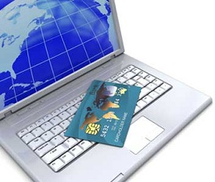
Banking
Today banking is almost totally dependent on computer.
Banks provide following facilities:
Banks provide online accounting facility, which includes current balances, deposits, overdrafts, interest charges, shares, and trustee records.
ATM machines are making it even easier for customers to deal with banks.

Slide 34
Insurance
Insurance companies are keeping all records up-to-date with the help of computers. The insurance companies, finance houses and stock broking firms are widely using computers for their concerns.
Insurance companies are maintaining a database of all clients with information showing
procedure to continue with policies
starting date of the policies
next due installment of a policy
maturity date
interests due
survival benefits

Slide 35
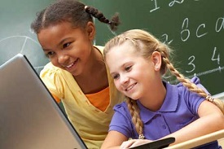
Education
The computer has provided a lot of facilities in the education system.
The computer provides a tool in the education system known as CBE (Computer Based Education).
CBE involves control, delivery, and evaluation of learning.
There are number of methods in which educational institutions can use computer to educate the students.
It is used to prepare a database about performance of a student and analysis is carried out on this basis.

Slide 36
Health Care
Computers have become important part in hospitals, labs, and dispensaries. The computers are being used in hospitals to keep the record of patients and medicines. It is also used in scanning and diagnosing different diseases. ECG, EEG, Ultrasounds and CT Scans etc., are also done by computerised machines.
Some major fields of health care in which computers are used are:
Diagnostic System - Computers are used to collect data and identify cause of illness.
Lab-diagnostic System - All tests can be done and reports are prepared by computer.
Patient Monitoring System - These are used to check patient's signs for abnormality such as in Cardiac Arrest, ECG etc.
Pharma Information System - Computer checks Drug-Labels, Expiry dates, harmful drug’s side effects etc.
Surgery : Nowadays, computers are also used in performing surgery.

Slide 37
Military
Computers are largely used in defence. Modern tanks, missiles, weapons etc. Military also employs computerised control systems. Some military areas where a computer has been used are:
Missile Control
Military Communication
Military Operation and Planning
Smart Weapons

Slide 38
Communication
Communication means to convey a message, an idea, a picture or speech that is received and understood clearly and correctly by the person for whom it is meant for. Some main areas in this category are:
E-mail
Chatting
FTP
Telnet
Video-conferencing

Slide 39
Classification Of Computers,

Slide 40
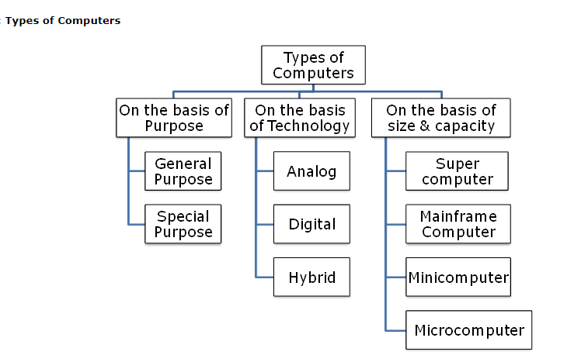

Slide 41
a) On the Basis of Purpose: According to utilization of computer for different uses, computers are of the following two types:
General Purpose Computers: These are general purpose computers that are used to perform a variety of tasks ranging from scientific as well as business purpose applications. They are generally found in homes and offices. Their uses include preparation of documents, letters, reports, gaming, financial analysis, data recording and analysis etc.
Special Purpose Computers: Special purpose computers are designed to perform only specialised task for which they are meant. For example weather forecasting, space research, air traffic control, medical diagnostic etc.

Slide 42
On the Basis of Technology Used: According to the technology used, computers can be classified into three categories:
Analog Computers: Analog computers use continuous physical quantities like pressure, temperature, length, voltage etc. and convert them into numeric values. They are very fast in operation as all the calculations are done in ‘parallel mode’. However, the accuracy and memory space of analog computers is less. . Examples of Analog computer include- thermometer (that measures the body or room temperature), speedometer (that measures the speed of an automobile), etc.

Slide 43
Digital Computers:
Most commonly used computers are digital computers. They represent data, whether numbers, letters, or symbols, in binary form (i.e. ‘0’ and ‘1’) and they work with numbers in the form of separate discrete digits. They are general purpose computers and can be used in different applications (like commercial, administrative and mathematical) since they can store different set of instructions and programs. Examples include PC, note books, work stations, smart phones etc.

Slide 44
Hybrid Computers:
Hybrid computers combine the features of both analog and digital computers. They incorporate the technology of both of them, i.e. the digital component normally serves as the controller and provides logical operations, while the analog component normally serves as a solver of differential equations. These computers use analog to digital and digital to analog converters to convert the analog signals into discrete numbers and digital numbers to analog signals. For example, in hospital’s Intensive Care Unit (ICU), a machine is used to monitor the blood pressure and temperature of the patient.

Slide 45
On the Basis of Size and Capacity

Slide 46
Types of Computers
The four basic types of computers are as under:

Slide 47
Supercomputer
Supercomputers are the fastest and the most expensive machines. They have high processing speed compared to other computers. The speed of a supercomputer is generally measured in FLOPS (FLoating point Operations Per Second). Some of the faster supercomputers can perform trillions of calculations per second. Supercomputers are built by interconnecting thousands of processors that can work in parallel.

Slide 48
These are specialized and task specific computers used by large organizations. These computers are used for research and exploration purposes, like NASA uses supercomputers for launching space shuttles, controlling them and for space exploration purpose.
The supercomputers are very expensive and very large in size. It can be accommodated in large air-conditioned rooms; some super computers can span an entire building.

Slide 49
Param Yuva 2
Param Yuva 2 is the supercomputer located at Center for Development of Advanced Computing (C-DAC) in Pune. The System is developed by Intel as OEM and system integrator is NetWeb technologies. Param Yuva 2 is ranked 251st in the world.

Slide 50
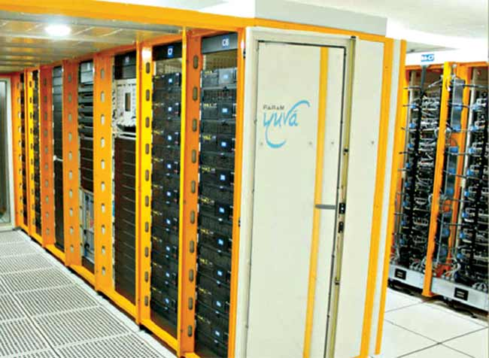

Slide 51
Specification :
Param Yuva 2 has 221 Intel Xeon E5-2670 nodes that also consist of Intel Xeon Phi 5110P, with Linux 64-bit (CentOS 6.2) and a total storage of 200TB. The System is rated at 388.44 TFLOPS. There are in all 3536 CPU cores and 26520 coprocessor cores. The system is interconnected with Mellanox FDR Infiniband primary interconnect for interconnection of nodes.
Param Yuva 2 provides service in fields of bioinformatics, space, weather forecasting, seismic data analysis, aerospace engineering, scientific research and pharmaceutical development

Slide 52
Earthquake studies
Supercomputers are used to study the Earthquakes phenomenon. Besides that supercomputers are used for natural resources exploration, like natural gas, petroleum, coal, etc.
Weather Forecasting
Supercomputers are used for weather forecasting, and to study the nature and extent of Hurricanes, Rainfalls, windstorms, etc.
Nuclear weapons testing
Supercomputers are used to run weapon simulation that can test the Range, accuracy & impact of Nuclear weapons.

Slide 53
Mainframe computer
Although Mainframes are not as powerful as supercomputers, but certainly they are quite expensive nonetheless, and many large firms & government organizations uses Mainframes to run their business operations. The Mainframe computers can be accommodated in large air-conditioned rooms because of its size. Super-computers are the fastest computers with large data storage capacity, Mainframes can also process & store large amount of data. Banks educational institutions & insurance companies use mainframe computers to store data about their customers, students & insurance policy holders.

Slide 54
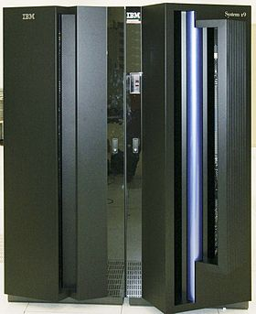
An IBM System z9 mainframe

Slide 55
Minicomputer
Minicomputers are digital computers, generally used in multi-user systems. They have high processing speed and high storage capacity than the microcomputers. Minicomputers can support 4–200 users simultaneously. The users can access the minicomputer through their
PCs or terminal. They are used for real-time applications in industries, research centers, etc. PDP 11, IBM (8000 series) are some of the widely used minicomputers.

Slide 57
Microcomputer
Microcomputers are small, low-cost and single-user digital computer. They consist of CPU, input unit, output unit, storage unit and the software. Although microcomputers are stand-alone machines, they can be connected together to create a network of computers that can serve more
than one user. IBM PC based on Pentium microprocessor and Apple Macintosh are some Well known manufacturers of Micro-computer are Dell, Apple, Samsung, Sony & Toshiba.

Slide 58
Desktop computers, Gaming consoles, Sound & Navigation system of a car, Netbooks, Notebooks, PDA’s, Tablet PC’s, Smartphones, Calculators are all type of Microcomputers.

Slide 59
Basic Organization of a Computer System / Block Diagram of computer System / Components of Computer Hardware

Slide 60
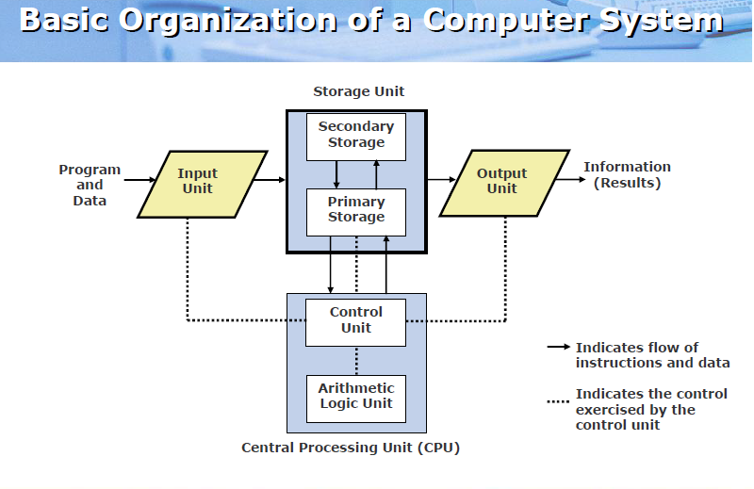

Slide 61
Input Unit
An input unit of a computer system performs the following functions:
It accepts (or reads) instructions and data from outside world
It converts these instructions and data in computer acceptable form
It supplies the converted instructions and data to the computer system for further processing
Ex: Keyboard, Mouse, Trackball etc.

Slide 62
Output Unit
An output unit of a computer system performs the following functions:
It accepts the results produced by the computer, which are in coded form and hence, cannot be easily understood by us
It converts these coded results to human acceptable (readable) form
It supplies the converted results to outside world

Slide 63
storage unit
The storage unit of a computer system holds (or stores) the following :
Data and instructions required for processing (received from input devices)
Intermediate results of processing
Final results of processing, before they are released to an output device

Slide 64
Central Processing Unit
Central Processing Unit : It is the brain of a computer system .CPU controls, coordinates and supervises the operations of the computer. It is responsible for processing of the input data. CPU consists of Arithmetic Logic Unit (ALU) and Control Unit (CU).
ALU performs all the arithmetic and logic operations on the input data.
CU controls the overall operations of the computer i.e. it checks the sequence of execution of instructions, and, controls and coordinates the overall functioning of the units of computer.

Slide 65
The System Concept
A system has following three characteristics:
A system has more than one element
All elements of a system are logically related
All elements of a system are controlled in a manner to achieve the system goal
A computer is a system as it comprises of integrated
components (input unit, output unit, storage unit, and CPU)
that work together to perform the steps called for in the
executing program

